Slide 1
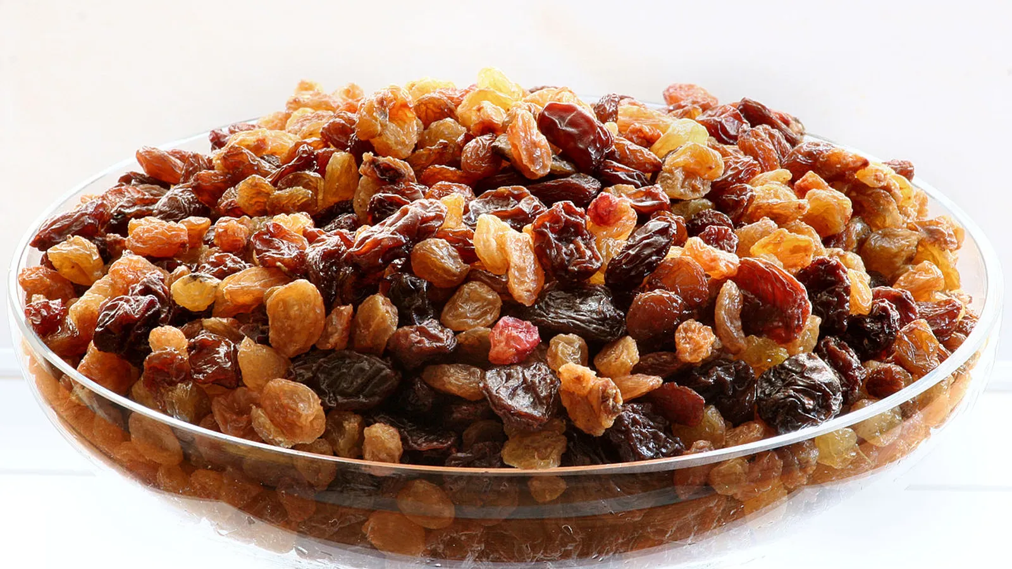
Raisin classification:
Machine learning algorithm written in Python to distinguish between two raisin types (Kecimen, Besni).
Data set containts 900 rows, 450 rows of each class.
Classification problem solved by Support-vector machine (SVM) algorithm.

Slide 2
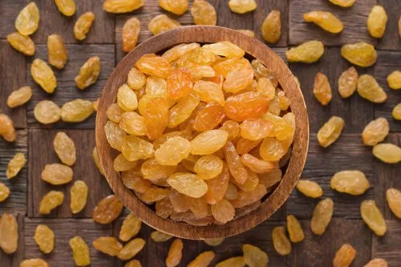
Raisin farming
Raisins are dried grapes. They are small and sweetly flavored, with a wrinkled texture. Raisins are produced in many regions of the world and may be eaten raw or used in cooking, baking, and brewing. In the United Kingdom, Ireland, New Zealand, and Australia, the word "raisin" refers to dark-colored, large dried grapes, with "sultana" referring to a golden-colored dried grape, and "currant" referring to a dried small Black Corinth grape.

Slide 3
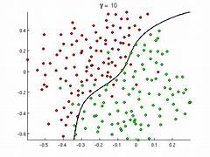
Objective :
To build a supervised machine learning model for classification of raisin on multiple attributes
The system that is being built must be feature based i.e, feature wise prediction must be possible
Providing graphical comparisons to provide a better view

Slide 4
Classification is dependemt of few factors like
AREA CLASS
MAJOR AXIS LENGTH KECIMEN
MINOR AXIS LENGTH BESNI
ECCENTRICITY
CONVEX AREA
PERIMETER
THIS ARE DIPENDENT
[ Y ]
THIS ARE INDIPENDENT
[ X ]

Slide 5
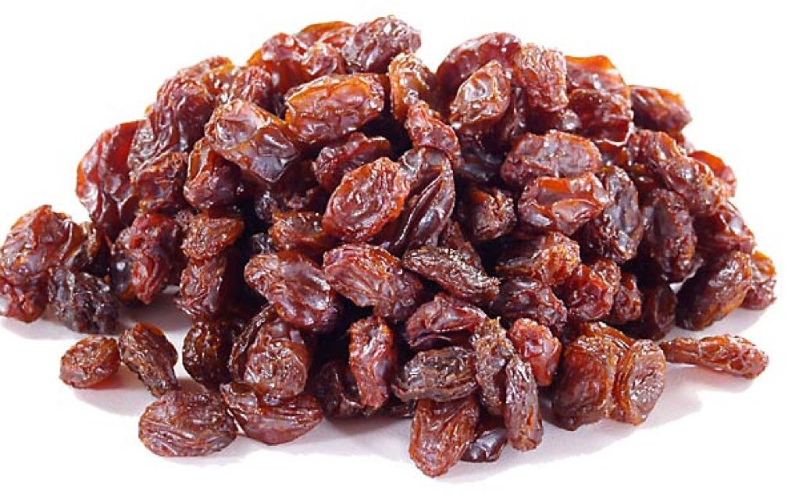
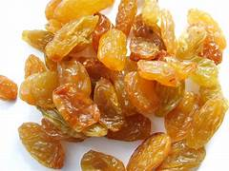
TYPES OF RAISIN IN WHICH WE ARE GOING TO CLASSIFY.
KECIMEN
BESNI

Slide 6
We have performed this prediction in jupyter Notebook
we imported the required libraries like
Numpy, pandas, Matplotlib, Seaborn
Sklearn for the task of algorithm Evaluation, Tunning, Preprocessing, label encoder, OneHot Encoder, Standard scaler
from sklearn.svm import SVC
from sklearn.metrics import accuracy_score, classification_report
from sklearn.metrics import confusion_matrix

Slide 7
:Then Reading the dataset. :Then done the data description
Reading the dataset
Data description in the form of
1 info
2 Head
3 Describe
4 Checking the null values
5 Tail
6 Identifying the data types
7 Checking Shape of data

Slide 8
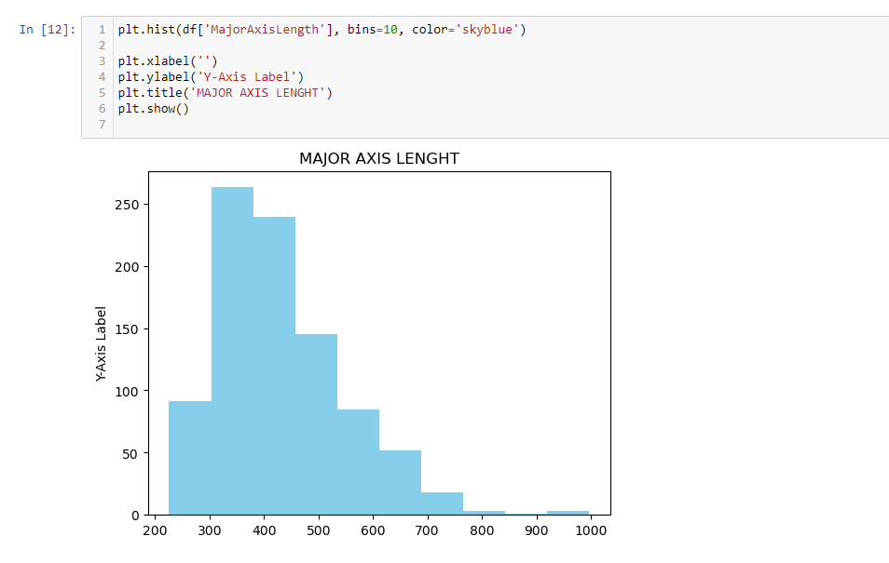
PERFORMING EDA HIST PLOT FOR MAJOR AXIS LENGHT

Slide 9
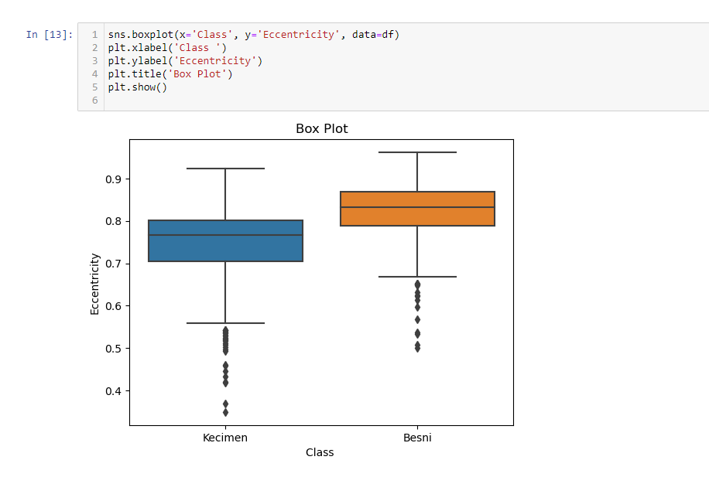
BOX PLOT FOR CLASS AND ECCENTRICITY.

Slide 10
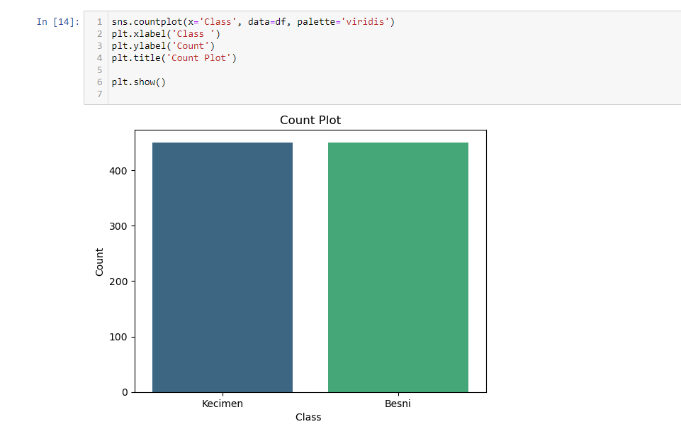
COUNT PLOT FOR CLASS

Slide 11
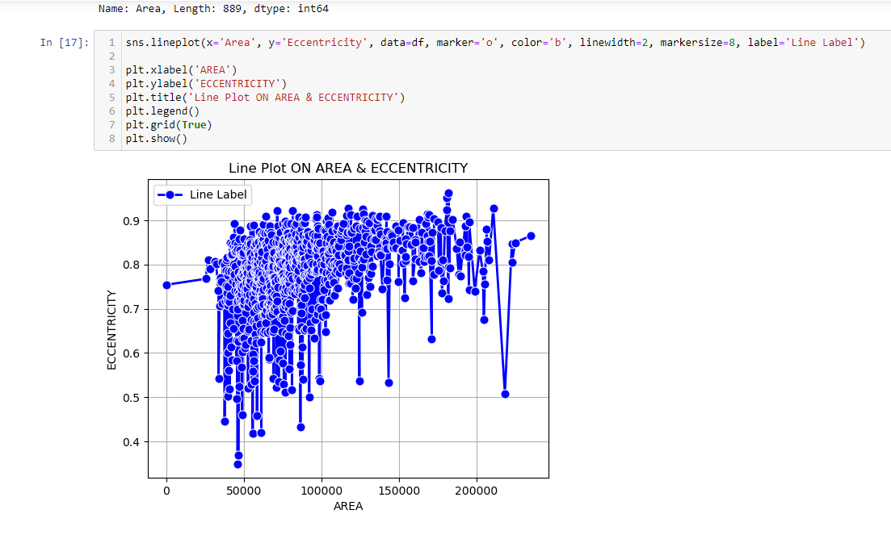
LINE PLOT FOR AREAA AND ECCENTRICITY.

Slide 12
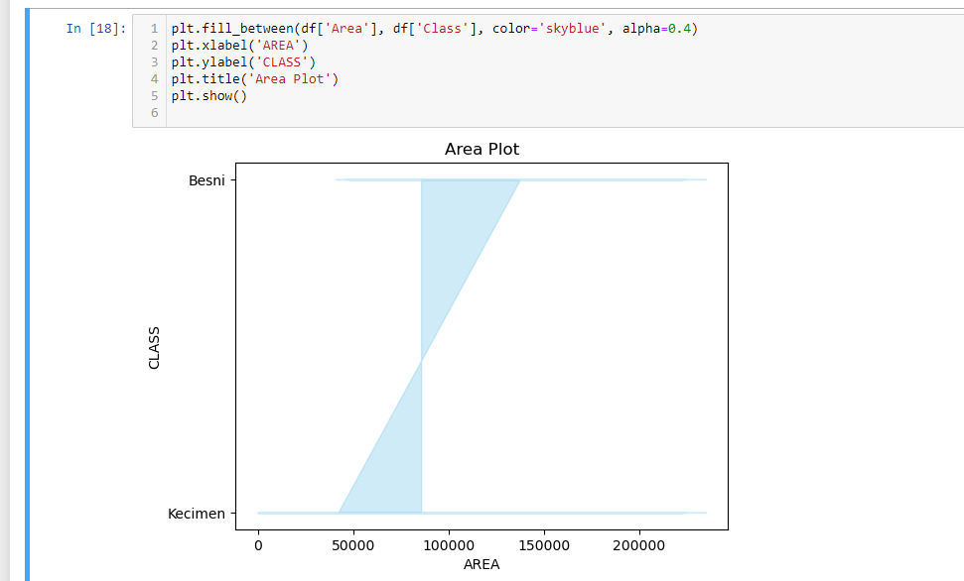
AREA PLOT FOR AREA AND CLASS

Slide 13
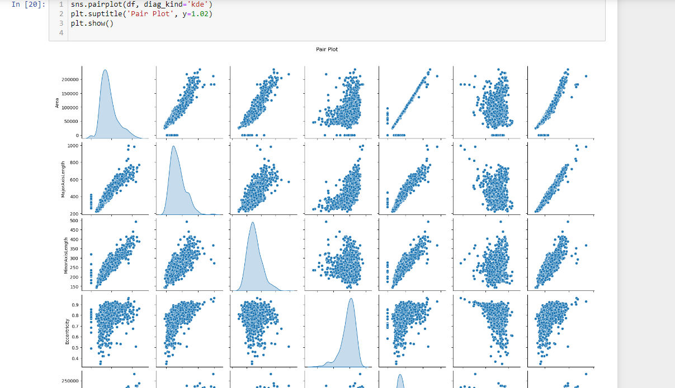
PAIR PLOT FOR WHOLE DATA

Slide 14
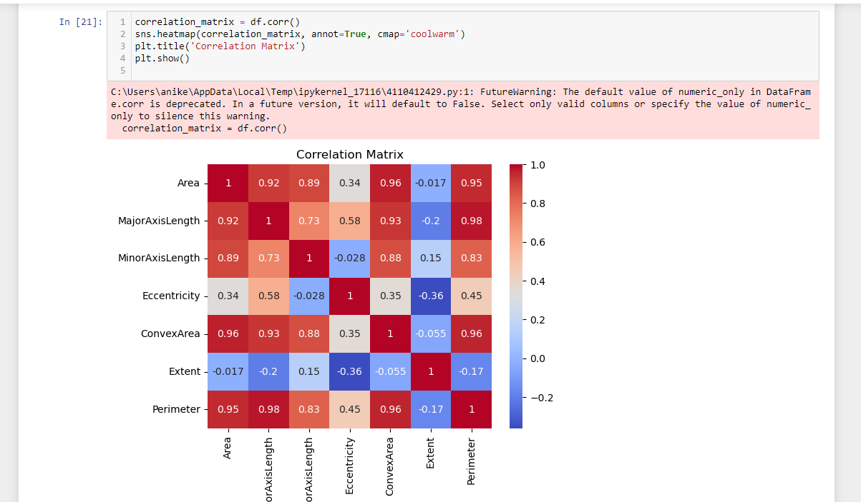
HEATMAP FOR CORRELATION MATRIX

Slide 15
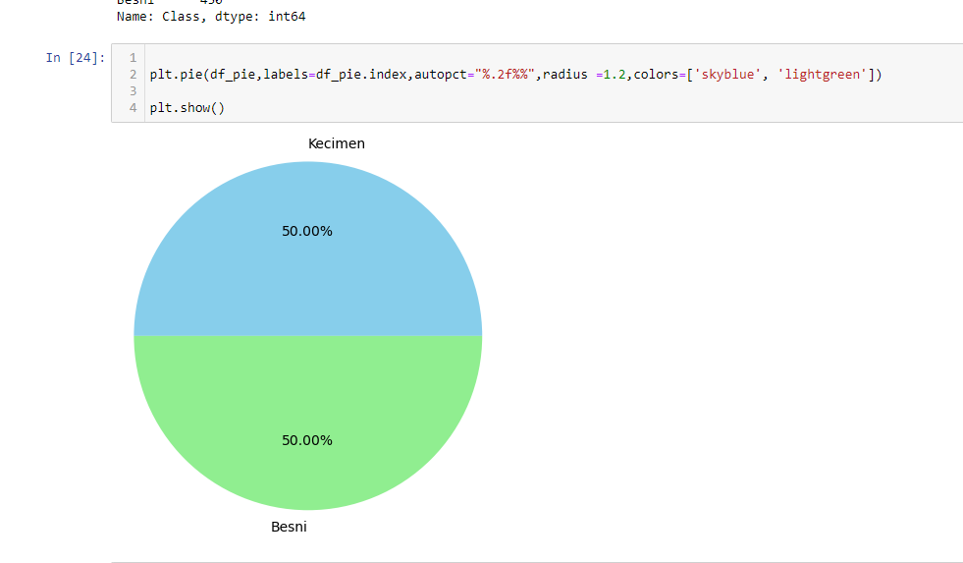
PIE PLOT FOR CLASS

Slide 16
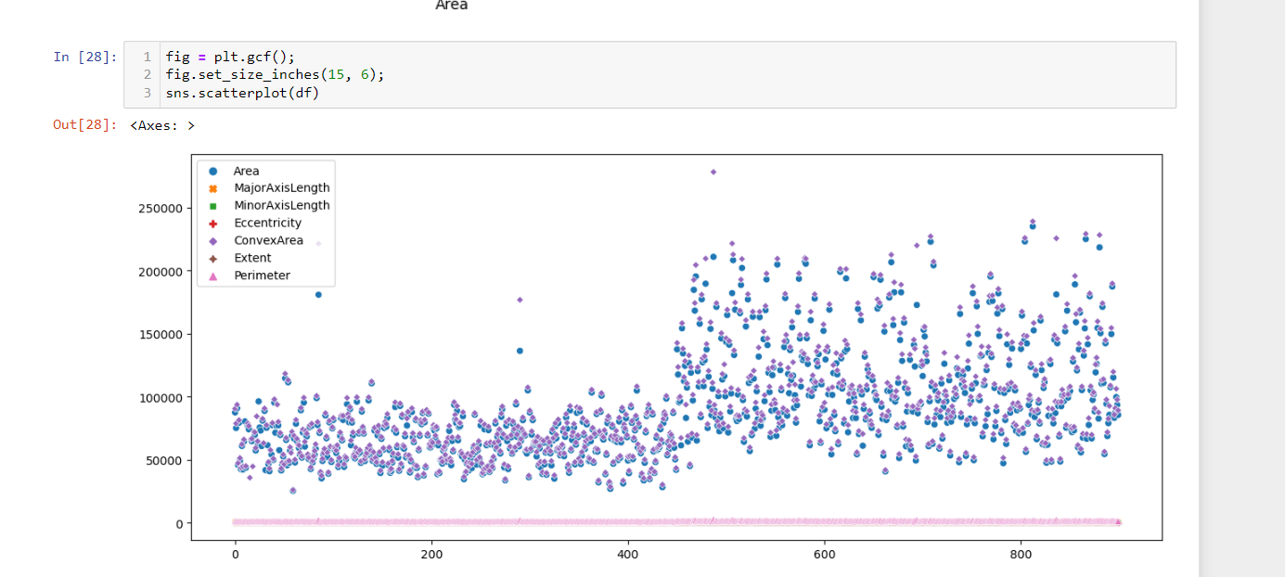
SCATTER PLOT

Slide 17
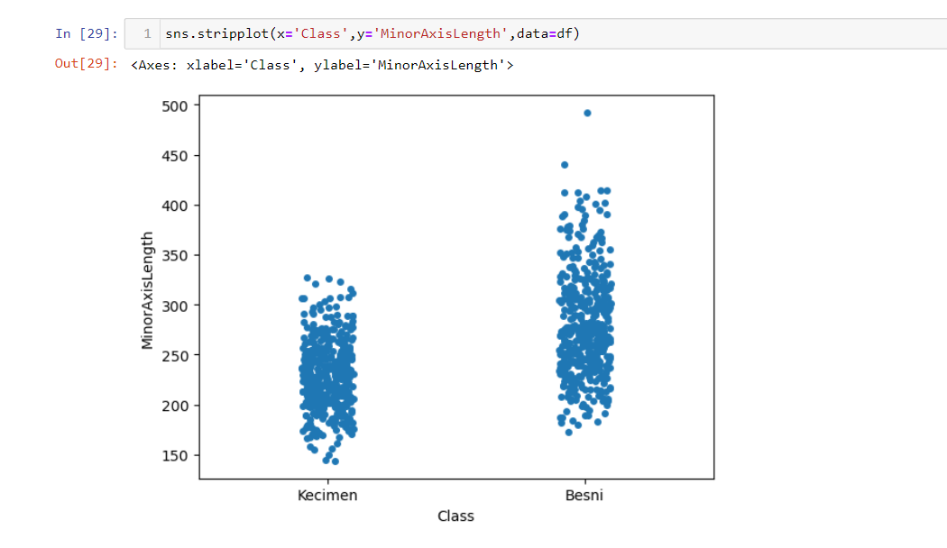
STRIP PLOT FOR MINOR AXIS LENGHT

Slide 18
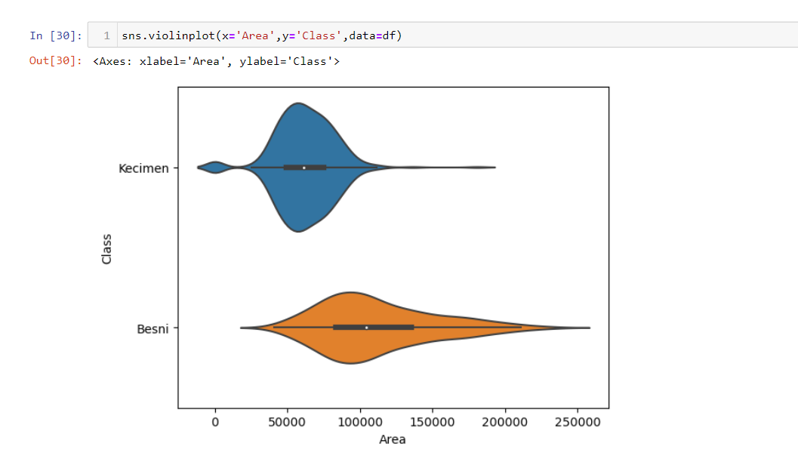
VIOLIN PLOT FOR AREA AND CLASS

Slide 19
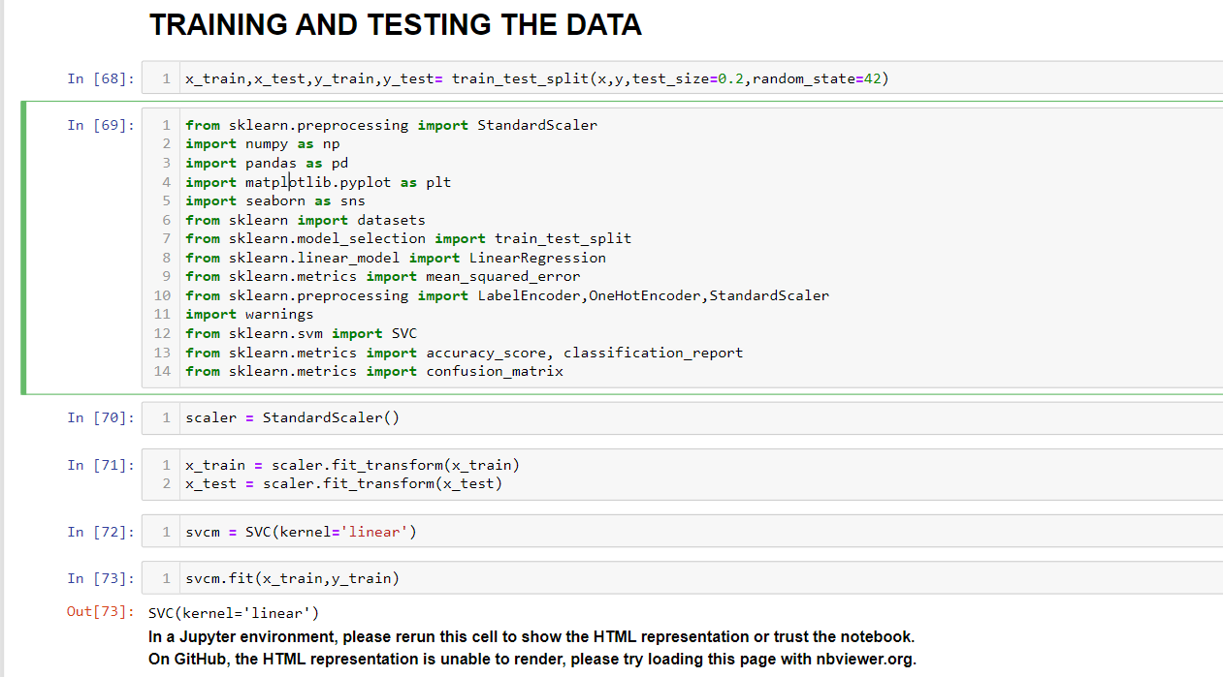
TRAINING AND TESTING THE DATA

Slide 20
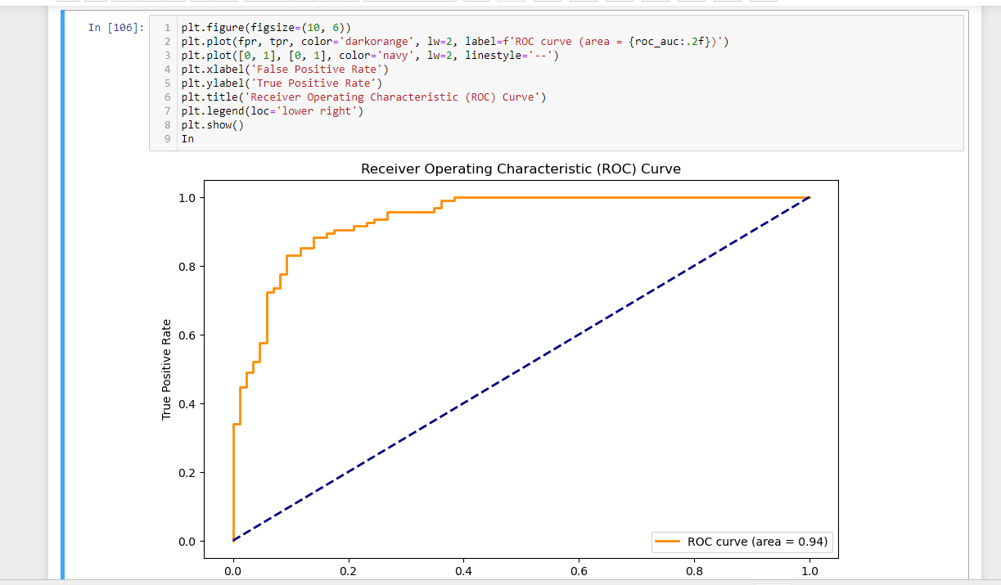
ROC CURVE FOR FPR AND TPR FOR SVM
GOT 86.1% ACCURACY

Slide 21
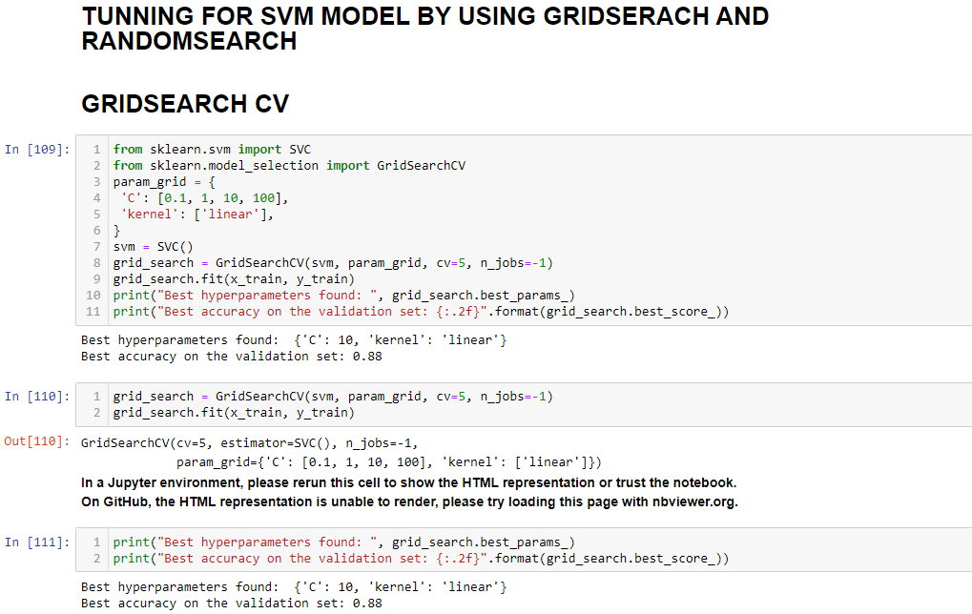
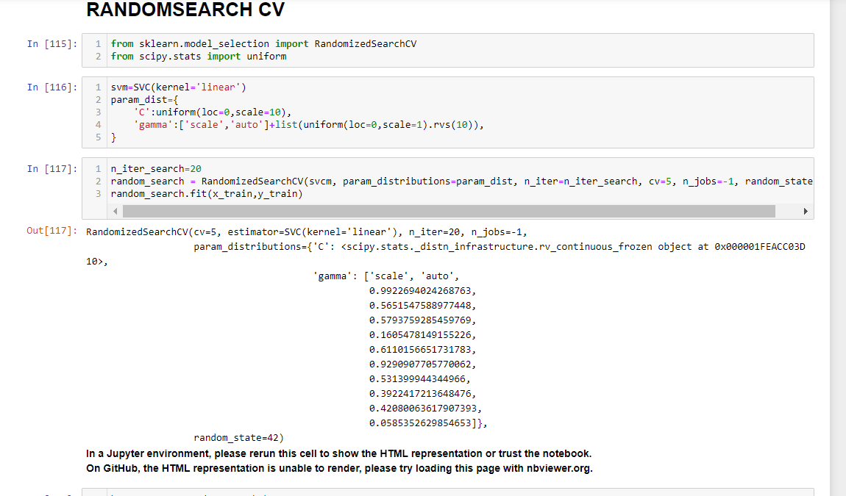
TUNNING OF SVM MODEL
GOT ACCURACY AFTER TUNNING :
GRID SEARCH : 88%
RANDOM SEARCH : 86%

Slide 22
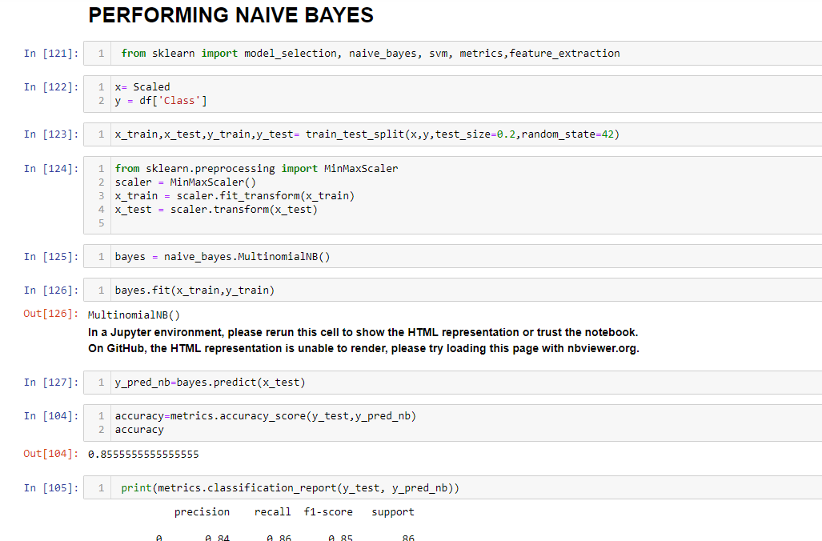
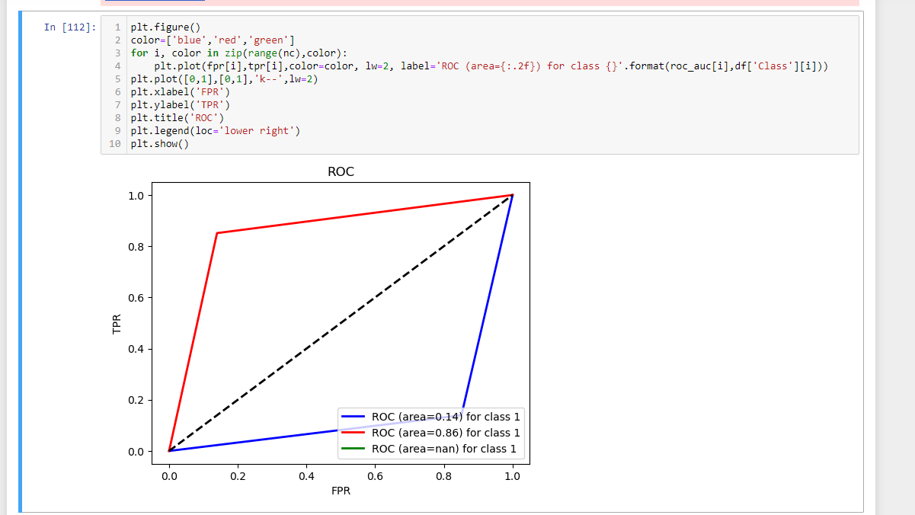
FOR NAÏVE BAYES:
GOT ACCURACY OF 85%

Slide 23
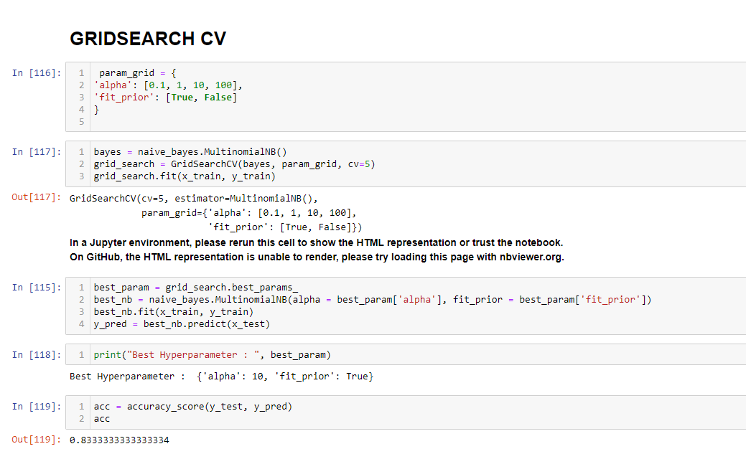
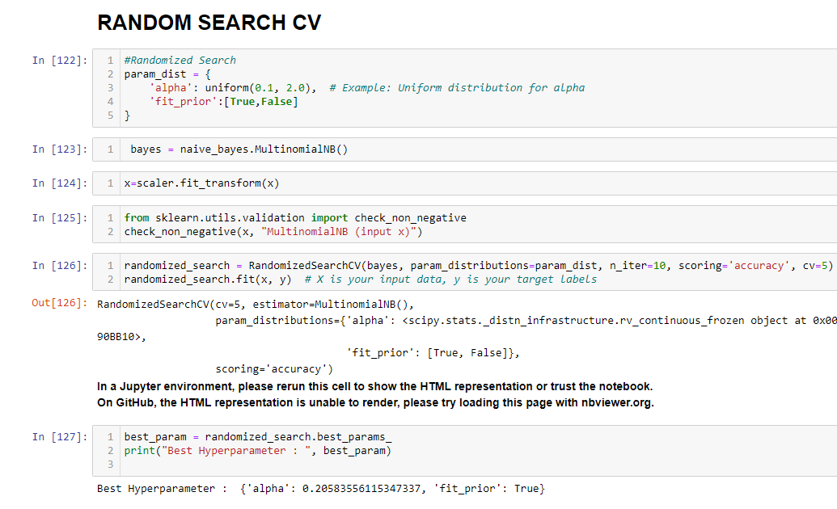
TUNNING FOR NAÏVE BAYES MODEL
GOT ACCURACY :
GRID SEARCH : 83%
RANDOM SEARCH : 85%

Slide 24

HERE WE SEEN THE CLASSIFICATION FOR RAISIN BY USING SVM AND NAIVE BAYES.
THANK YOU
Aniket Chavan

